Slide 1
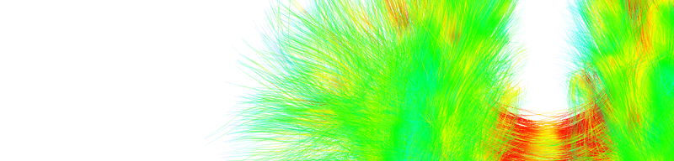



Diffusion
Tractography
Eleftherios Garyfallidis, Ph.D.
Diffusion Imaging in Python
http://dipy.org
Sherbrooke Connectivity Imaging
Laboratory (SCIL)
http://scil.dinf.usherbrooke.ca
Notes:
Merci Gilles Kahn

Slide 2
Basic principles

Slide 3
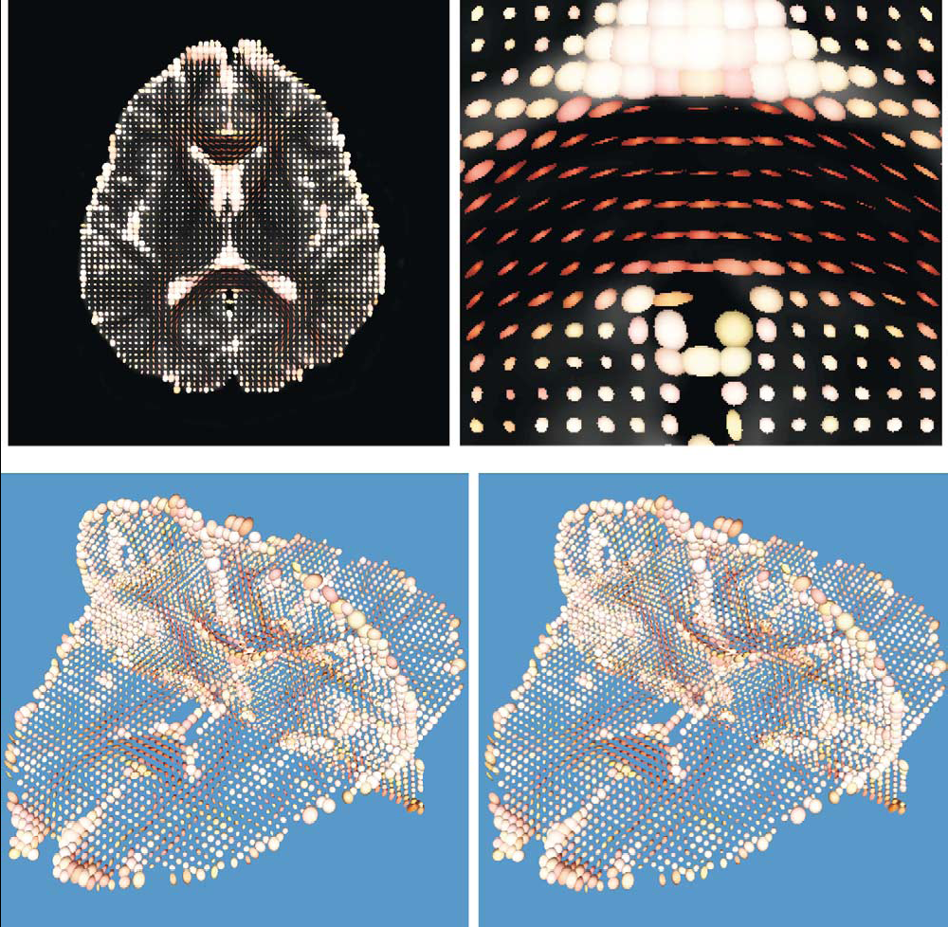
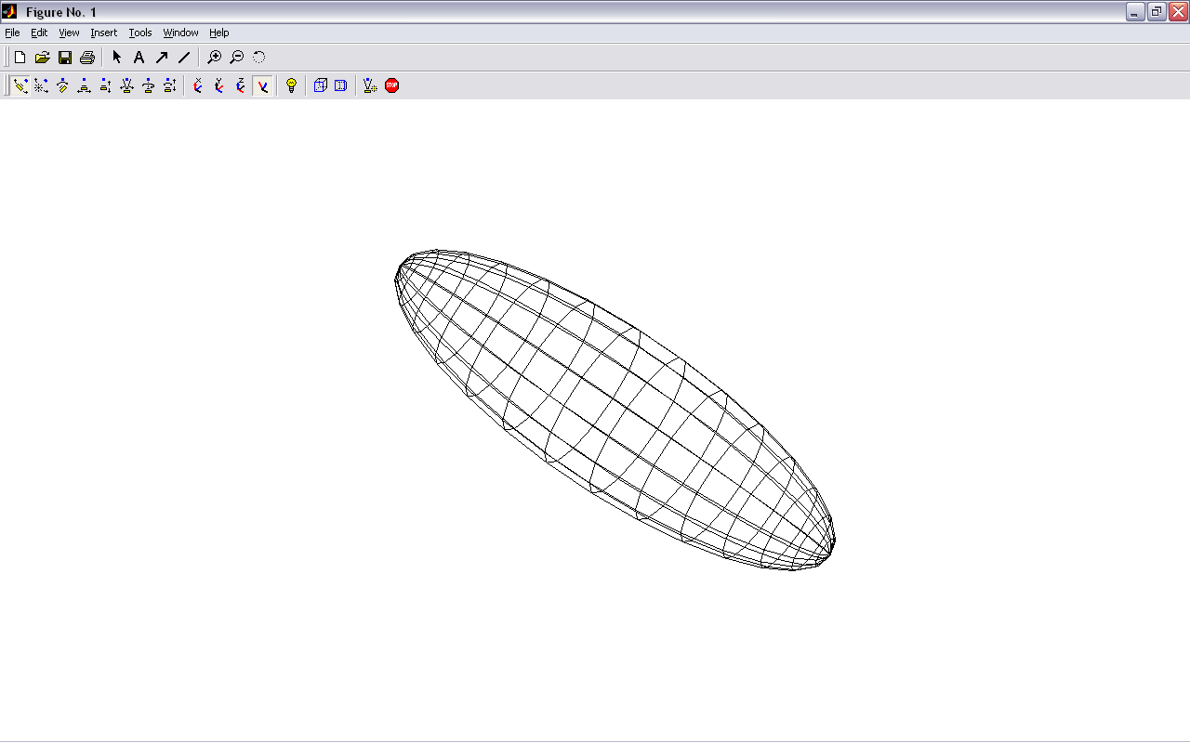
Main idea: Tensor-based tracking
z
v₁
λ₁
v₂
v₃
x
Y.Masutani et al.” European Journal of Radiology 46 (2003)

Slide 4
Connect the main directions voxel to voxel
z
v₁
λ₁
v₂
v₃
x

Slide 5
Deterministic tracking
If we assume the main eigenvector is tangential to the underlying trajectory of the white matter
Starting from a seed point we can propagate a 3D curve that represents the WM pathway
v₁
Two main approaches :
FACT - (Mori et al. 1999)
Interpolated Streamlines (Euler, RK, etc) - (Basser et al. 2000)
Streamline Tractography
Seed Point

Slide 6
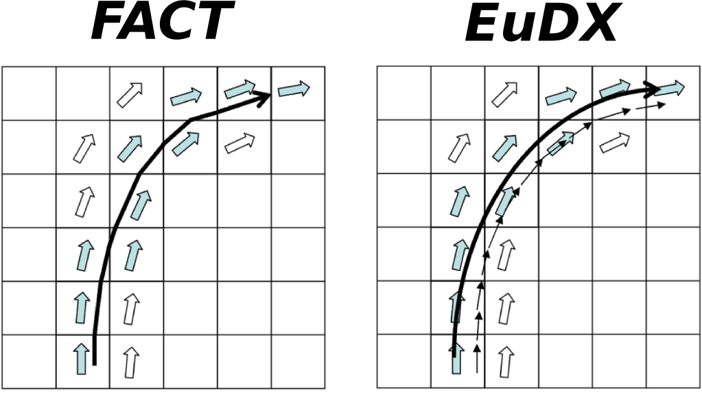

Deterministic tracking
FACT Interpolated
The track follows a path parallel to the principal eigenvector until the border of the voxel.
The step size is not fixed
Works well with low curvature regions
At each step a new direction is interpolated taking into account the surrounding eigenvectors
Step size is fixed
New Position
Old Position
Step Size
Principal Eigenvector
= + x
E

Slide 7
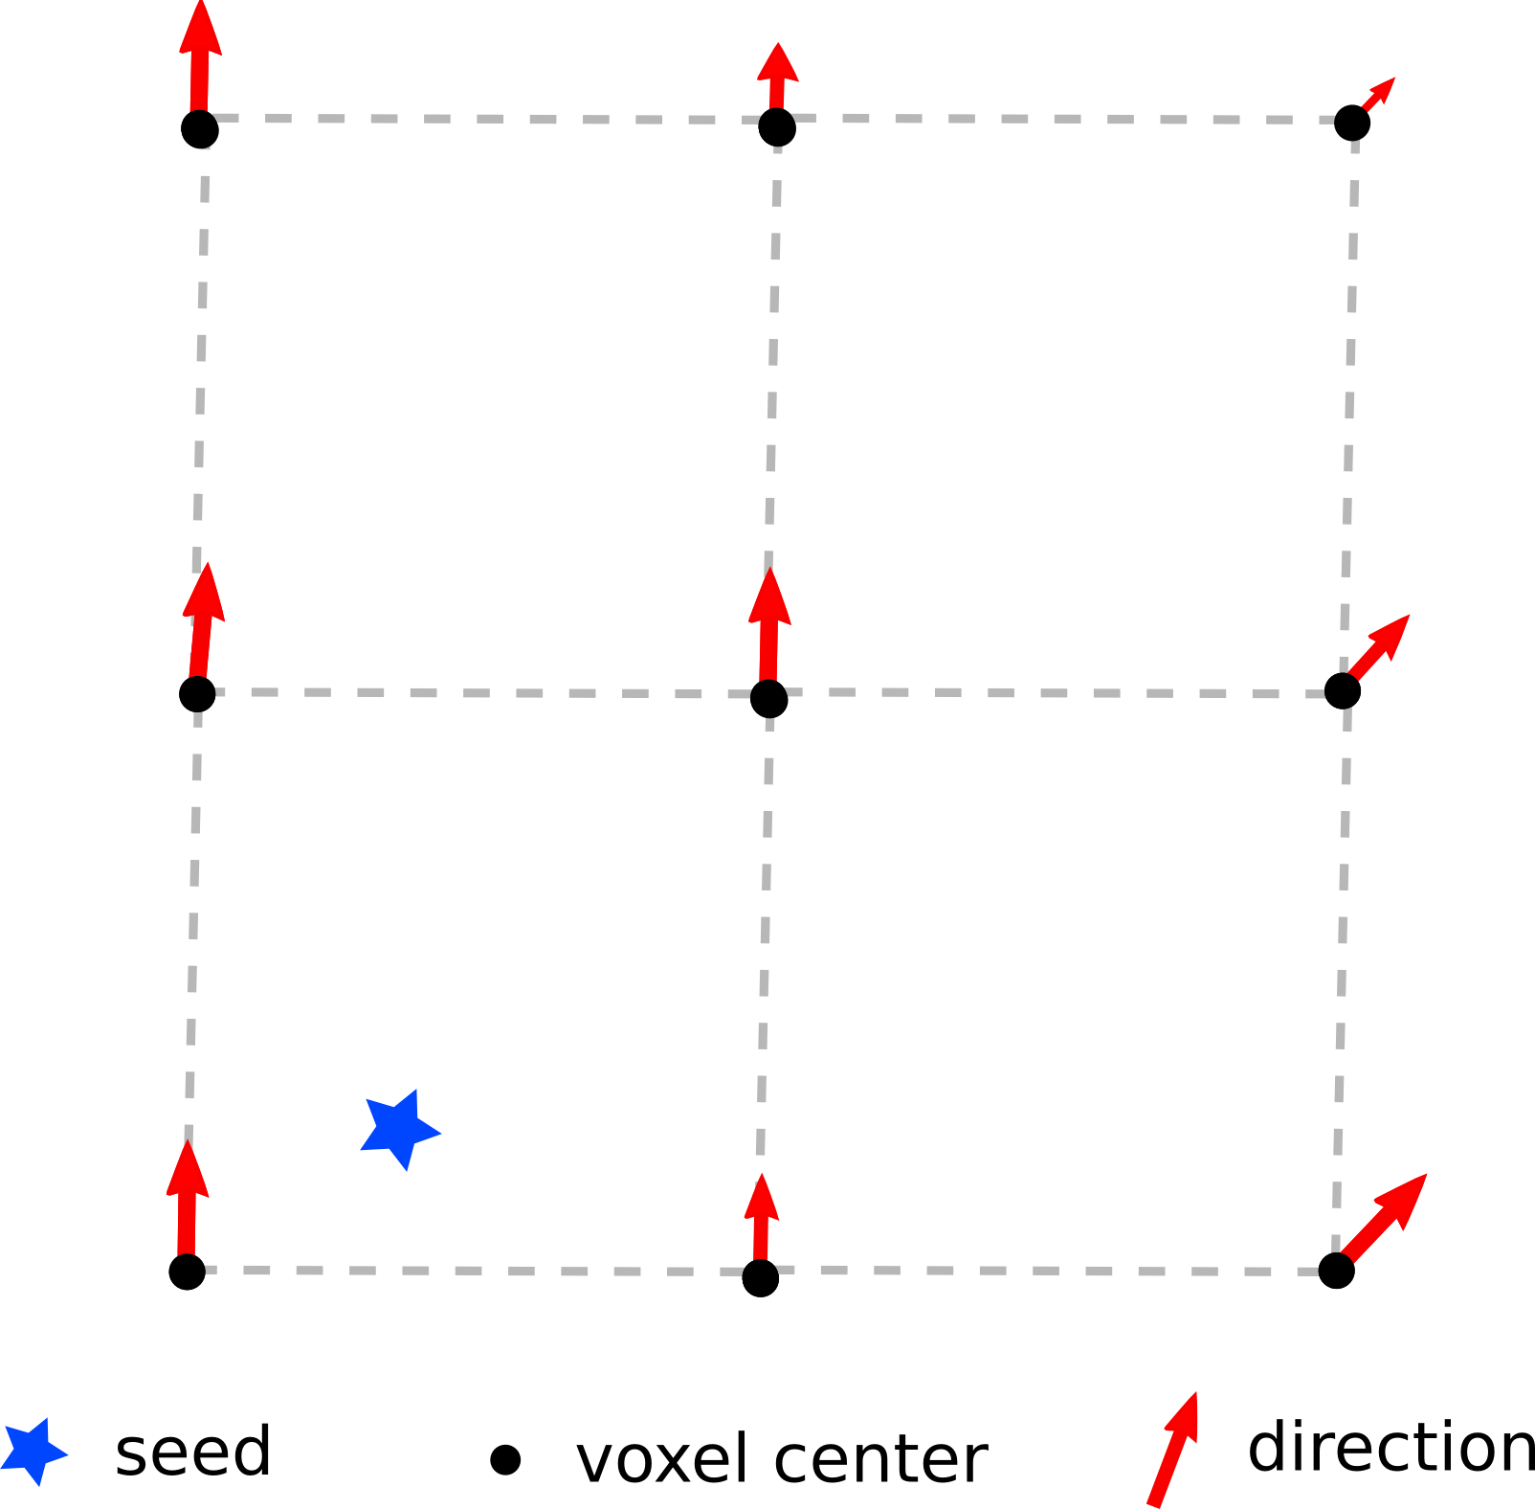
Euler Integration
Everything starts with a seed
E

Slide 8
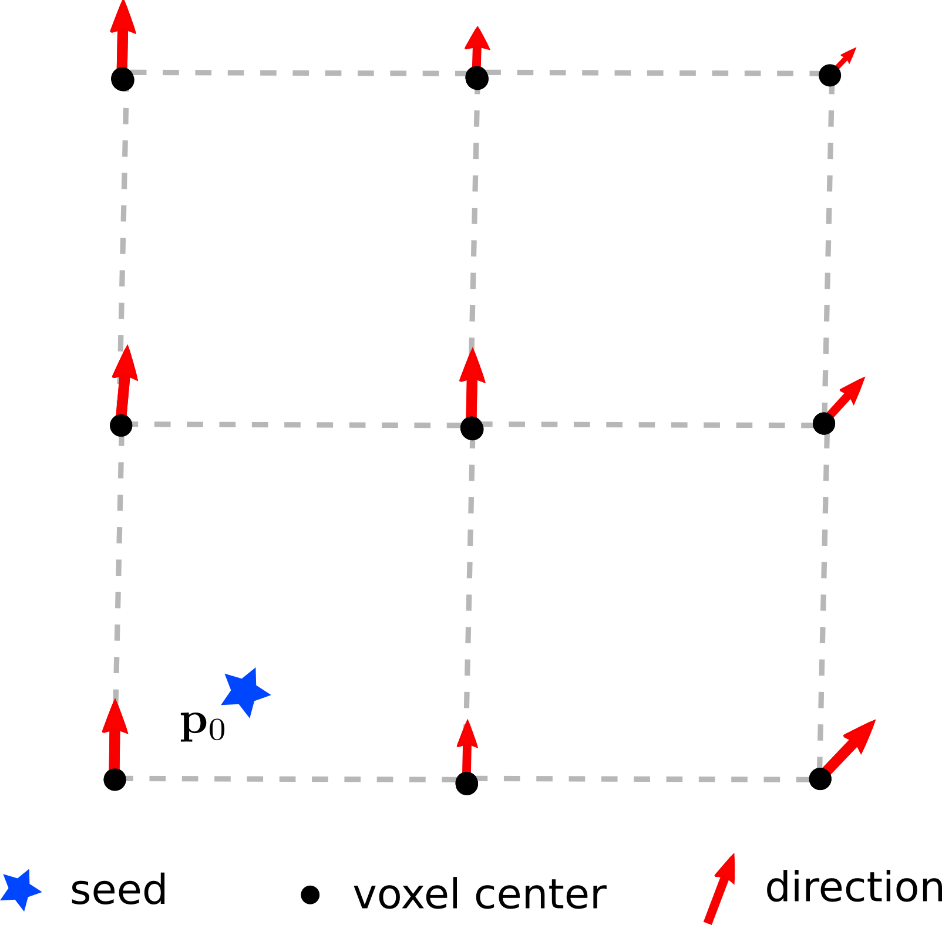
Euler Integration
Seed at position p0
E

Slide 9
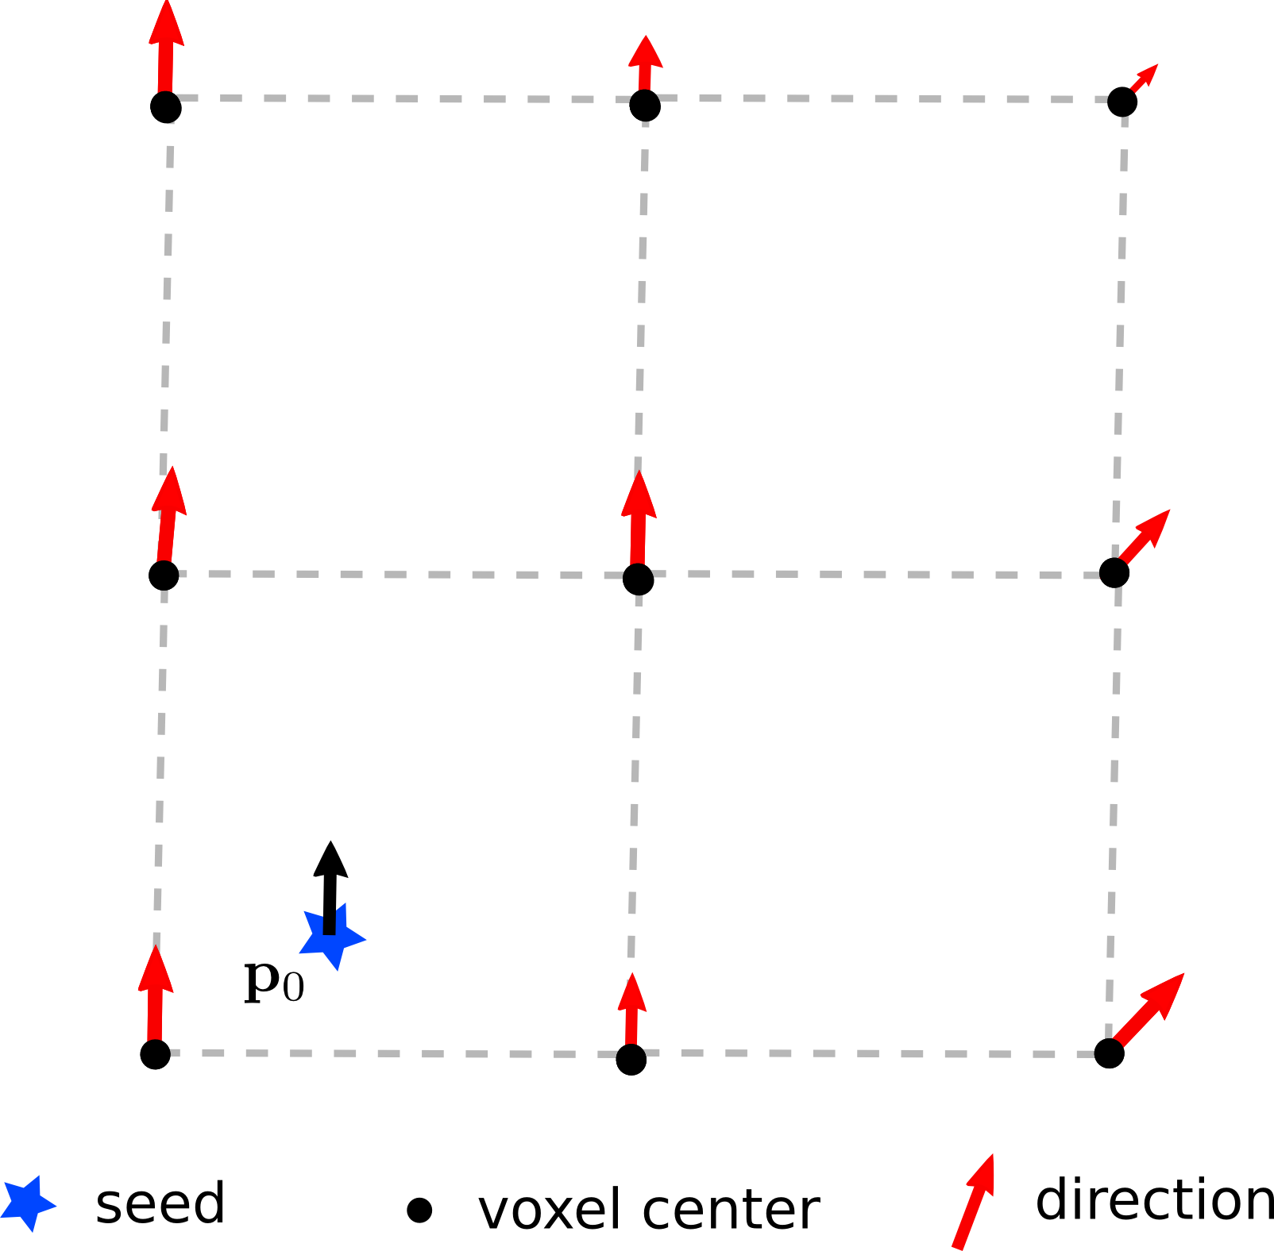
Euler Integration
Direction to follow is an interpolation of the
directions/peaks from adjacent voxels
E

Slide 10
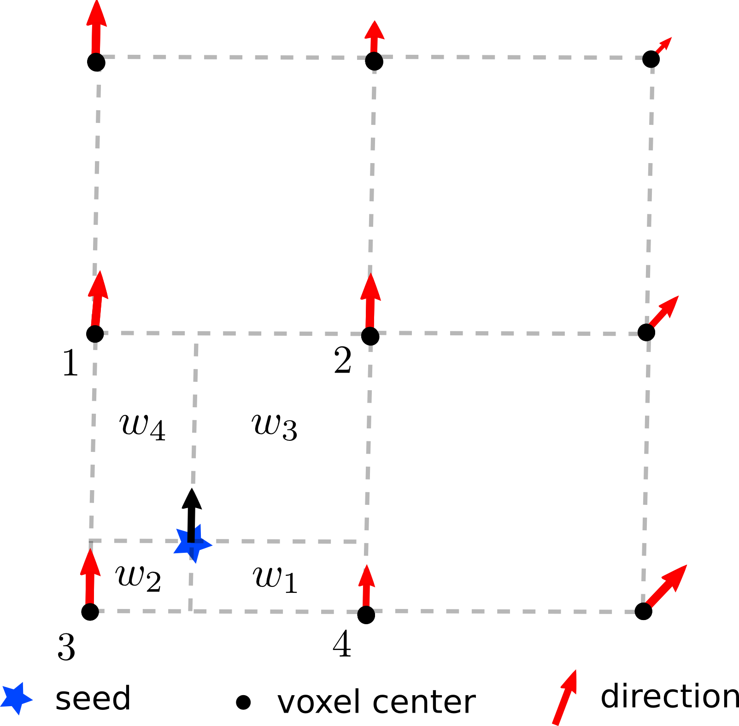
Euler Integration
The interpolation is usually trilinear …
E

Slide 11
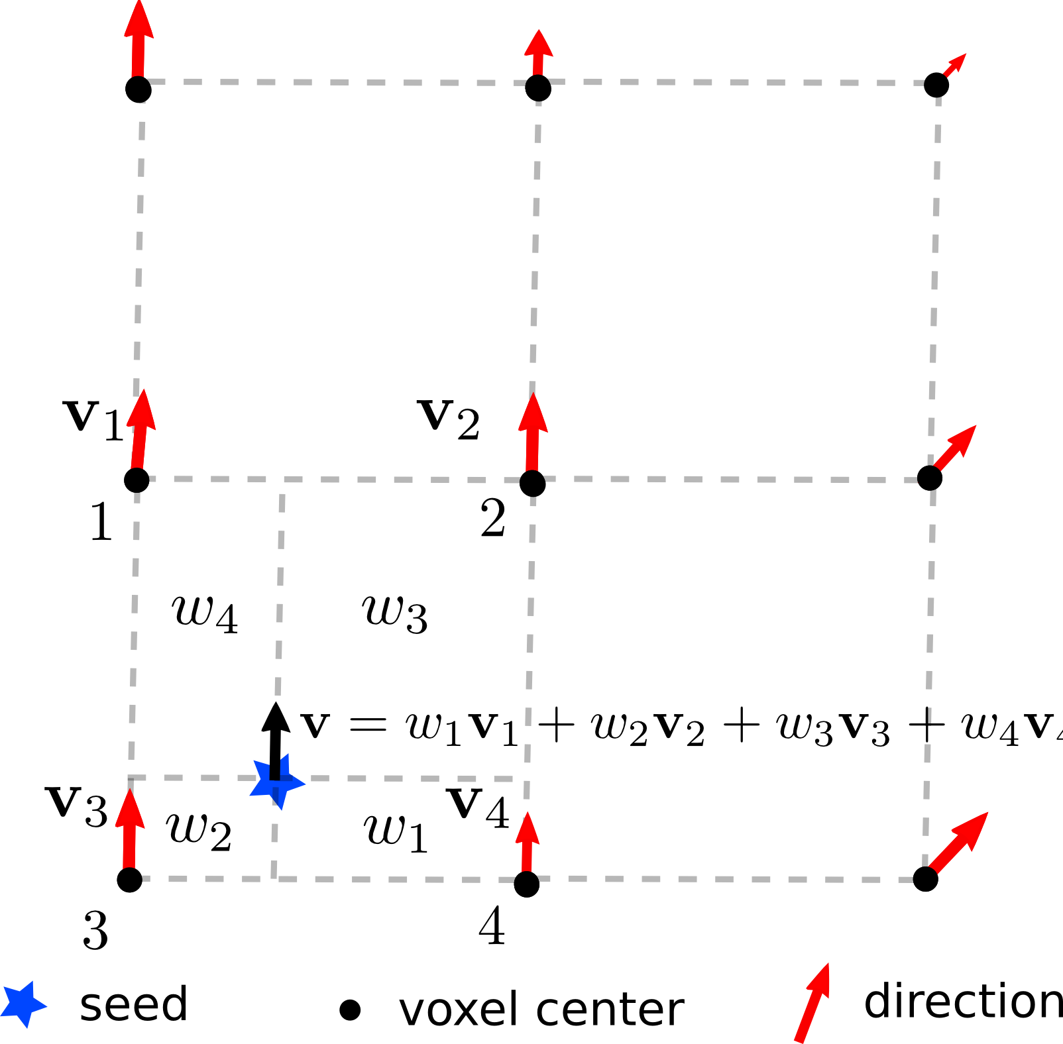
Euler Integration
Which means that the current direction
is a weighted sum of the adjacent vectors
E

Slide 12
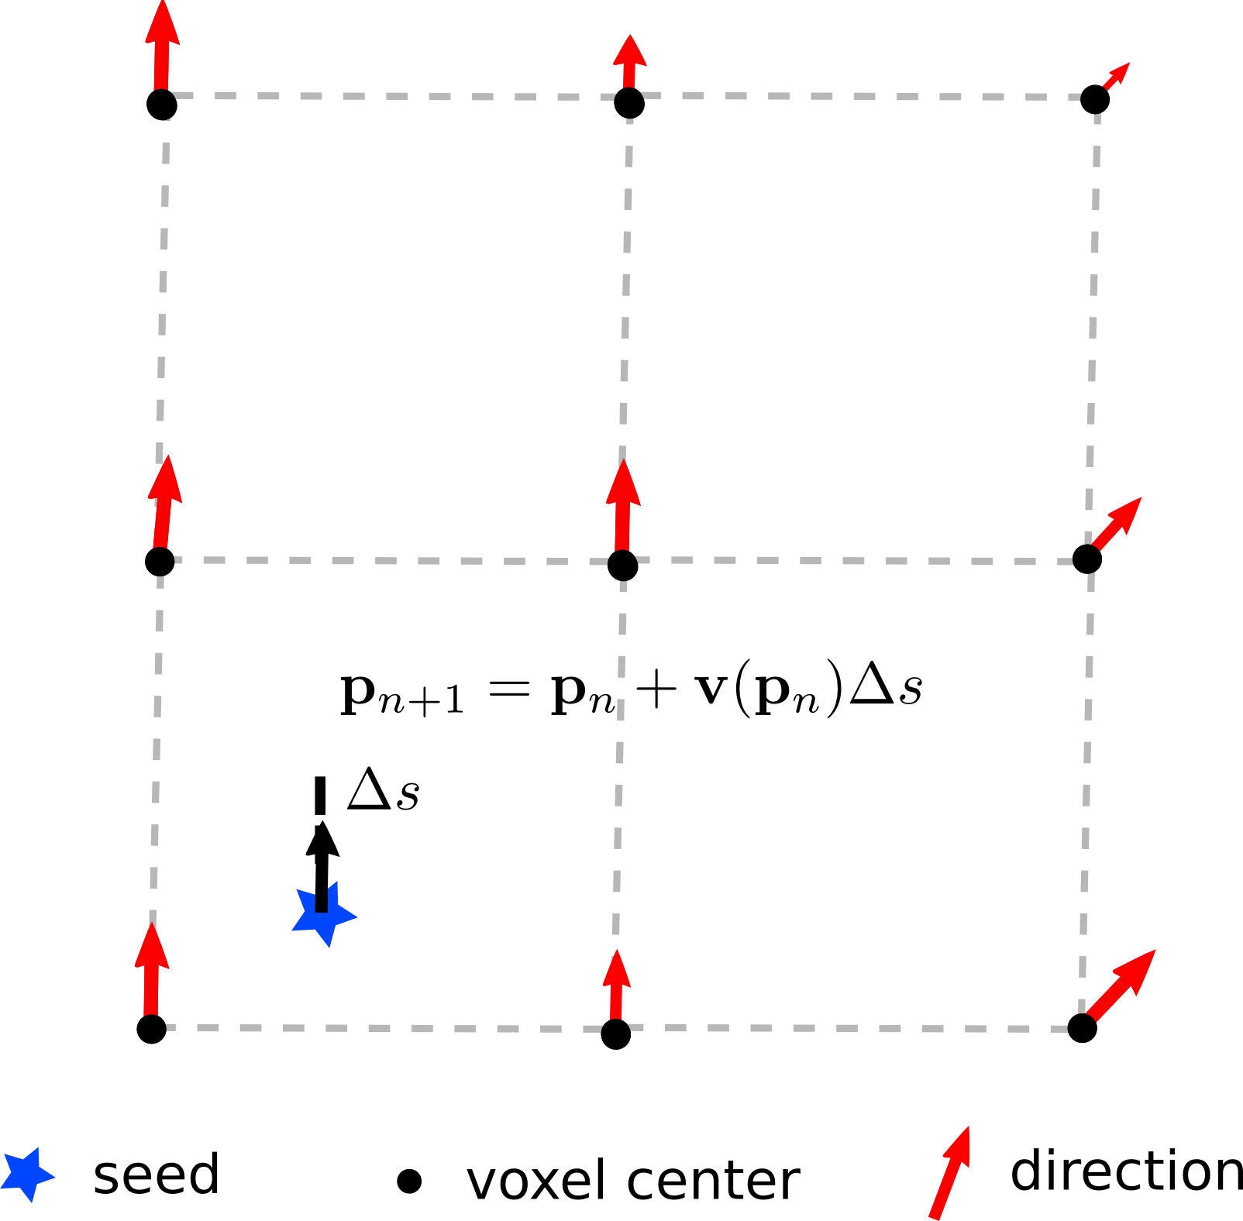
Euler Integration
Euler integration is used for the next direction
and again is a simple vector addition.
E

Slide 13
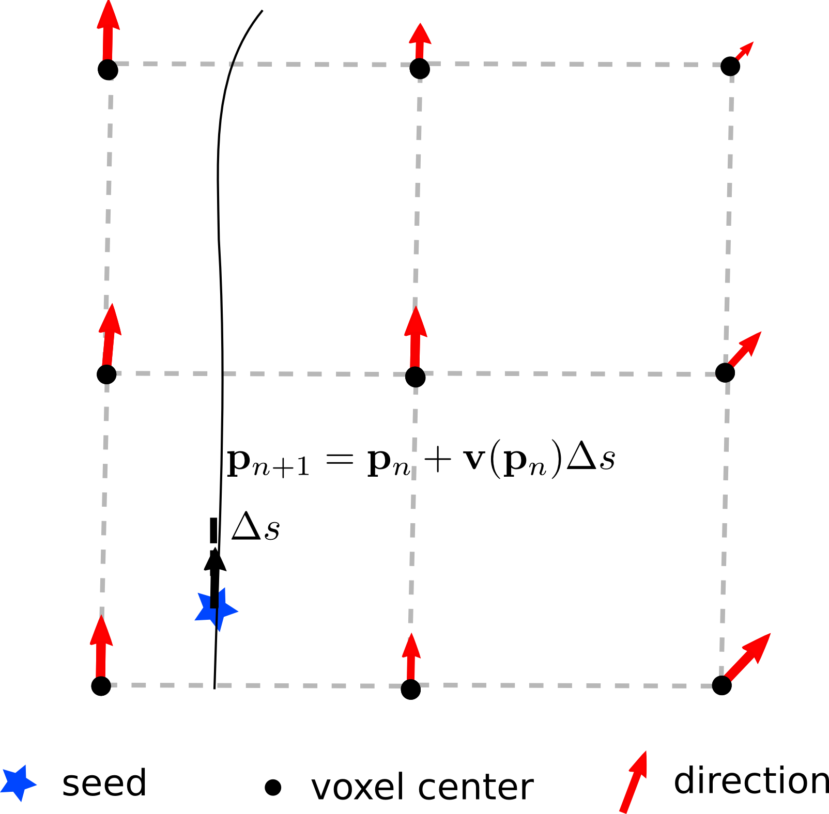
Euler Integration
By saving point by point we get the entire streamline
as a polyline. Be careful… we need to track backward too…
E

Slide 14
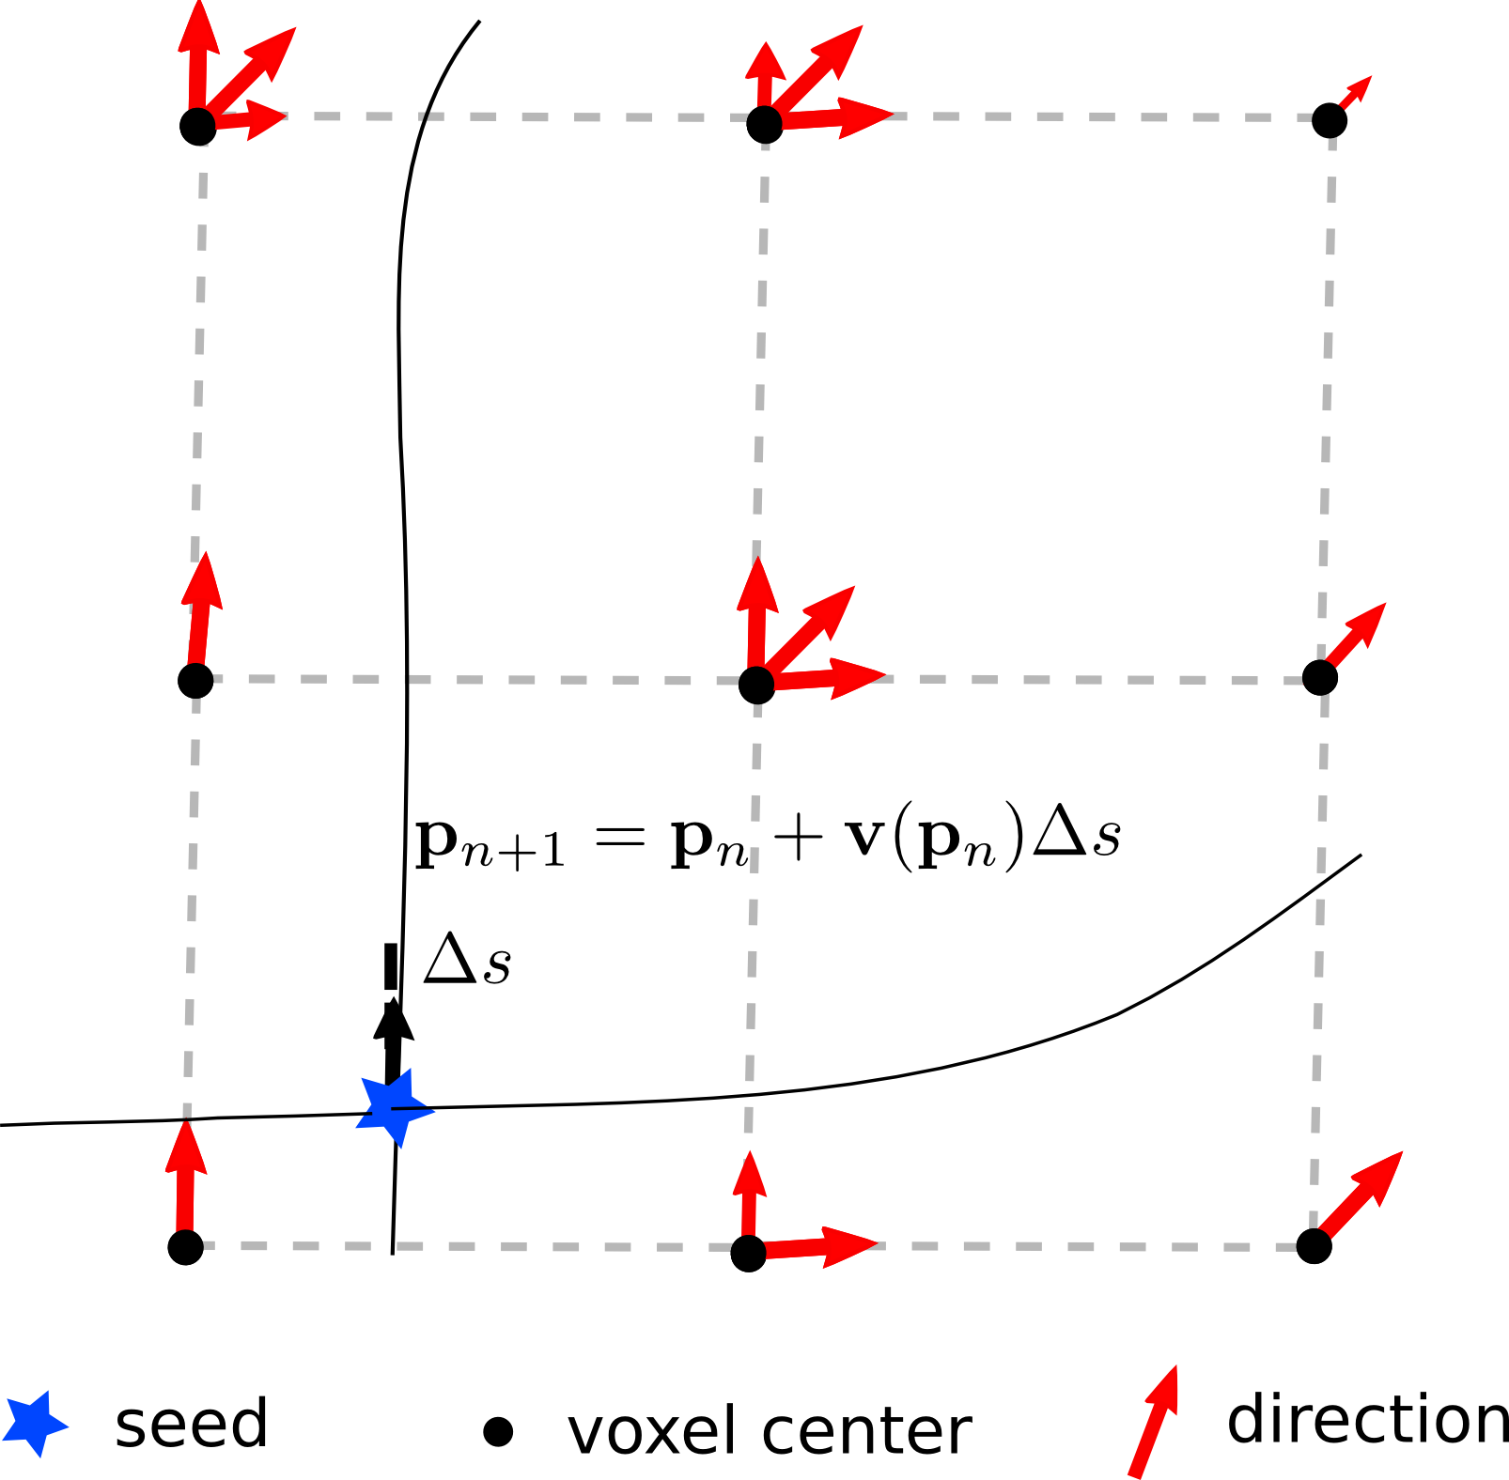

Euler Integration
And what if we have multiple crossings?
Garyfallidis et al., Frontiers 2014, Dell’ Acqua et al. HBM 2013, Yeh et al. TMI 2010
E

Slide 15
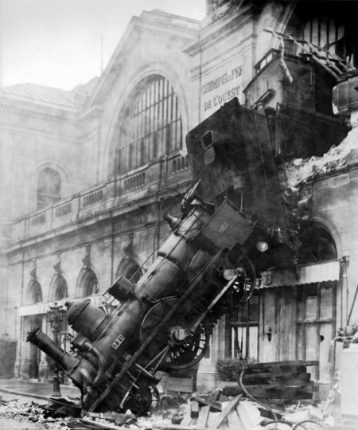
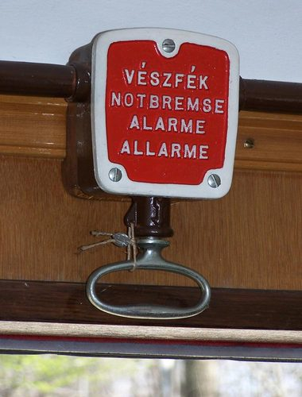
Stopping rules
How to stop streamlines ?
E

Slide 16
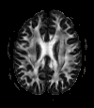
Stopping rules
How to stop streamlines ?
Level of Anisotropy
Start if FA > threshold and Stop if FA < threshold (FA ~0.15/0.20)
To avoid regions with low anisotropy (high noise effect and variability)
To avoid tracking in regions like CSF and GM
Angle of curvature
Fibers should not turn too sharply
Stop if the ANGLE between the old and new direction is > threshold
it depends on the algorithm used (e.g FACT vs Euler)
It depends on the resolution of your dataset
θ
E

Slide 17
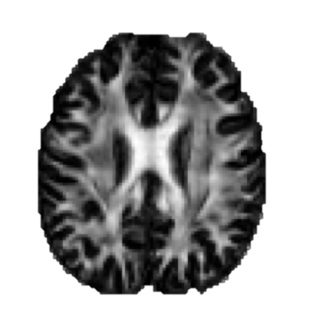
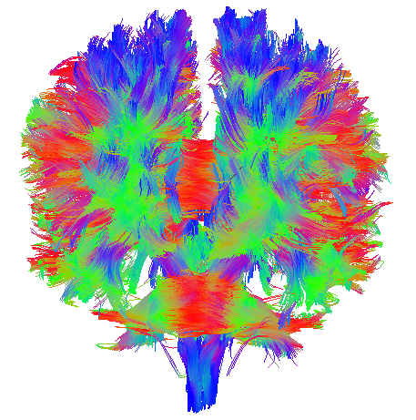
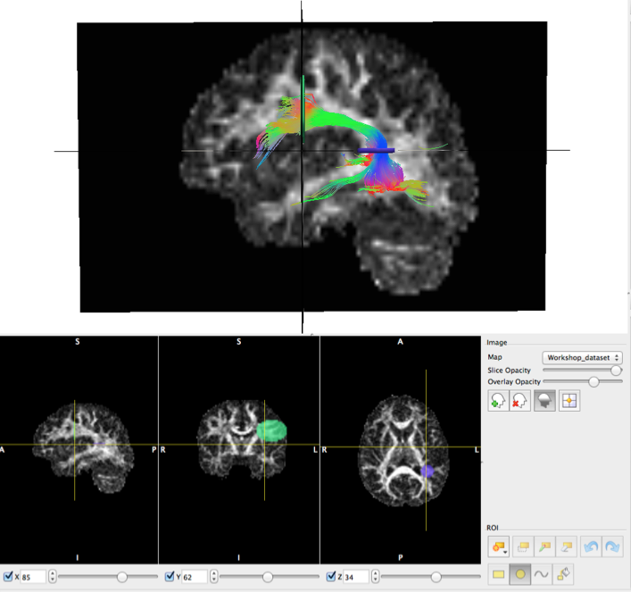
Whole brain seeding
Types of ROIs:
Inclusion (logical “and” and “or”)
Exclusion (logical “not”)
How we use ROIs:
Termination Points (e.g. Cortical)
Waypoints (e.g. specific white matter region)
Volumetric (e.g. U-Shape)
Wakana et al. Neuroimage 2007
Catani et al. Cortex 2008

Slide 18
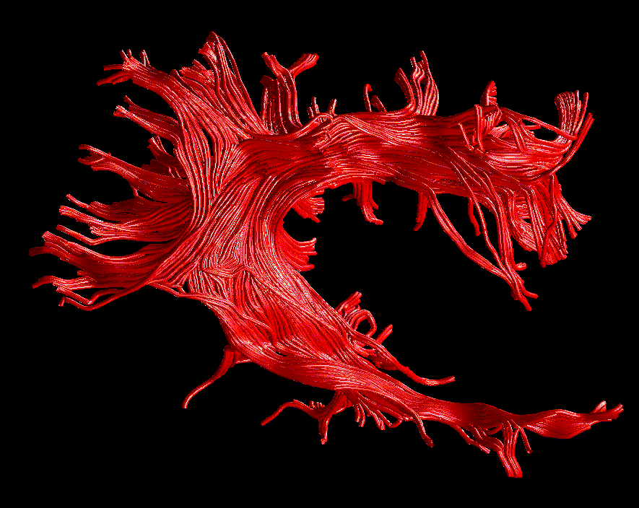
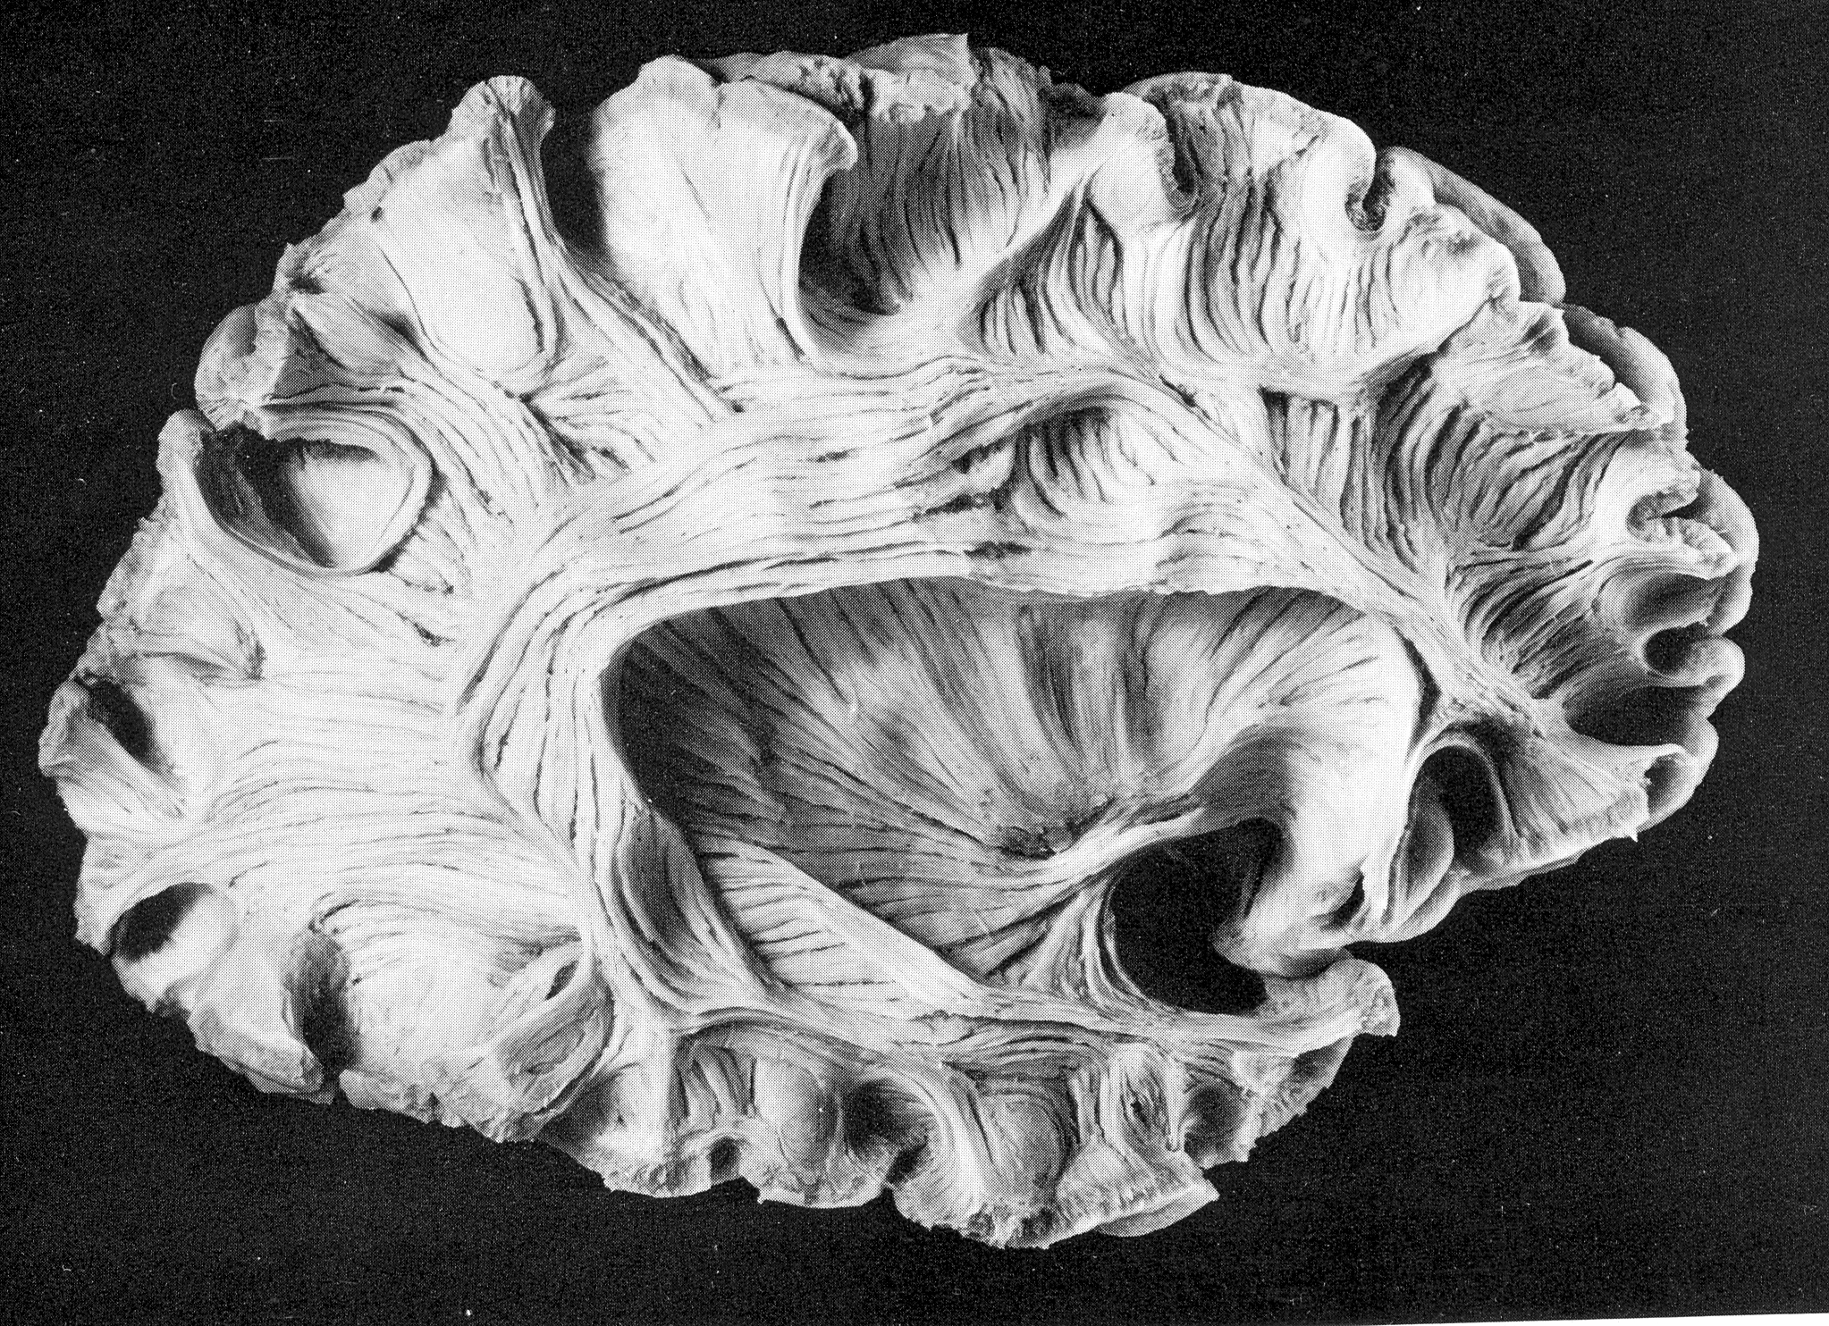
The result
Arcuate Fasciculus
SHORT FIBRES
LONG FIBRES
Virtual In-Vivo Dissection
Post-Mortem Dissection
Lights and Streamtubes are used to obtain a better 3D visualization.
The size of the tubes is arbitrary and it doesn’t represent the real fascicles!
Catani et al. NeuroImage 2002

Slide 19
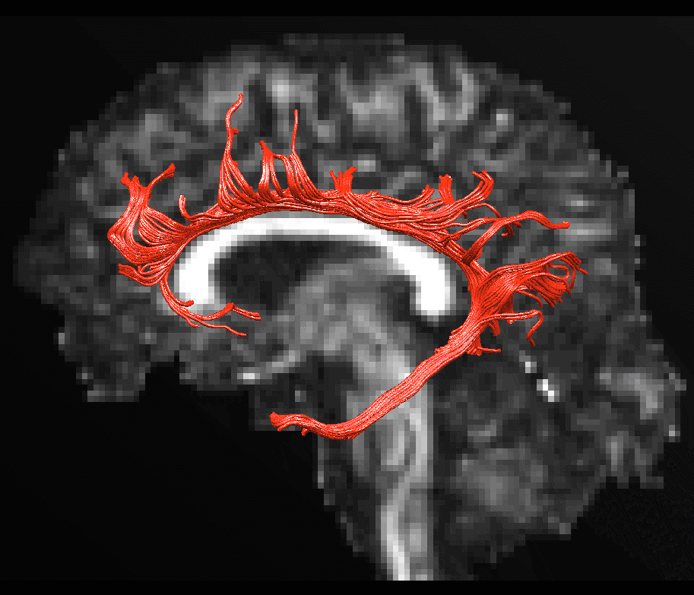
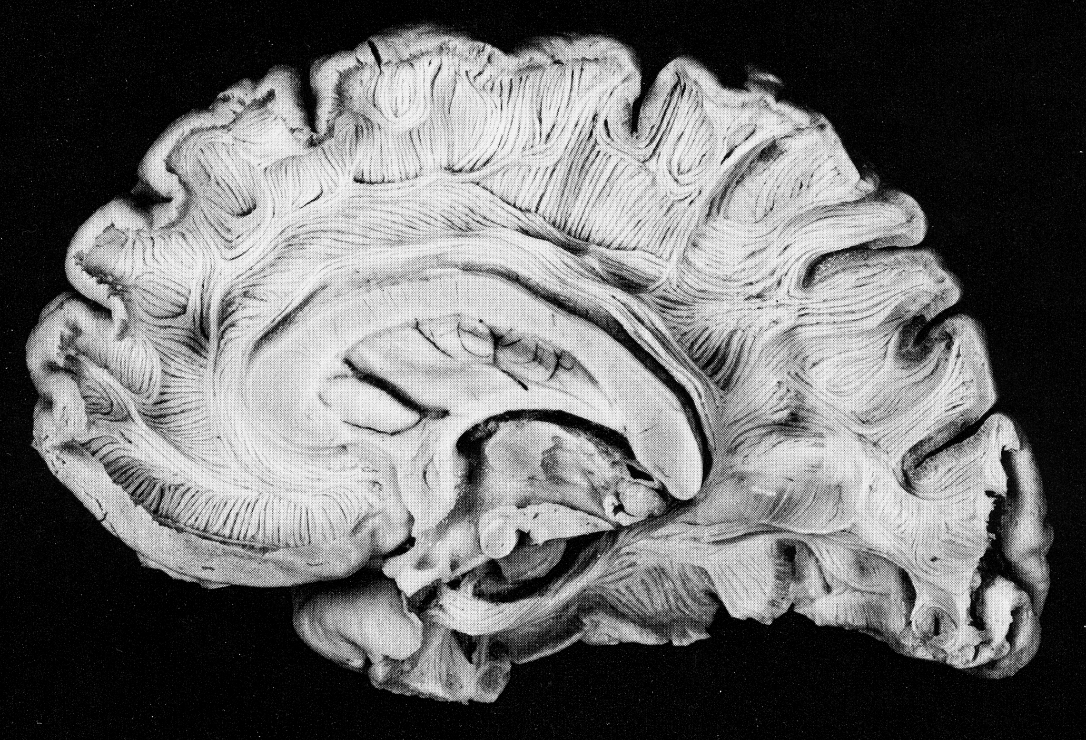
The result
Cingulum
SHORT FIBRES
FRONTAL FIBRES
PARIETAL FIBRES
LONG FIBRES
OCCIPITAL FIBRES
TEMPORAL FIBRES
Virtual In-Vivo Dissection
Post-Mortem Dissection
Lights and Stream-tubes are used to obtain a better 3D visualization.
The size of the tubes is arbitrary and it doesn’t represent the real fascicles!
Catani et al. NeuroImage 2002

Slide 20
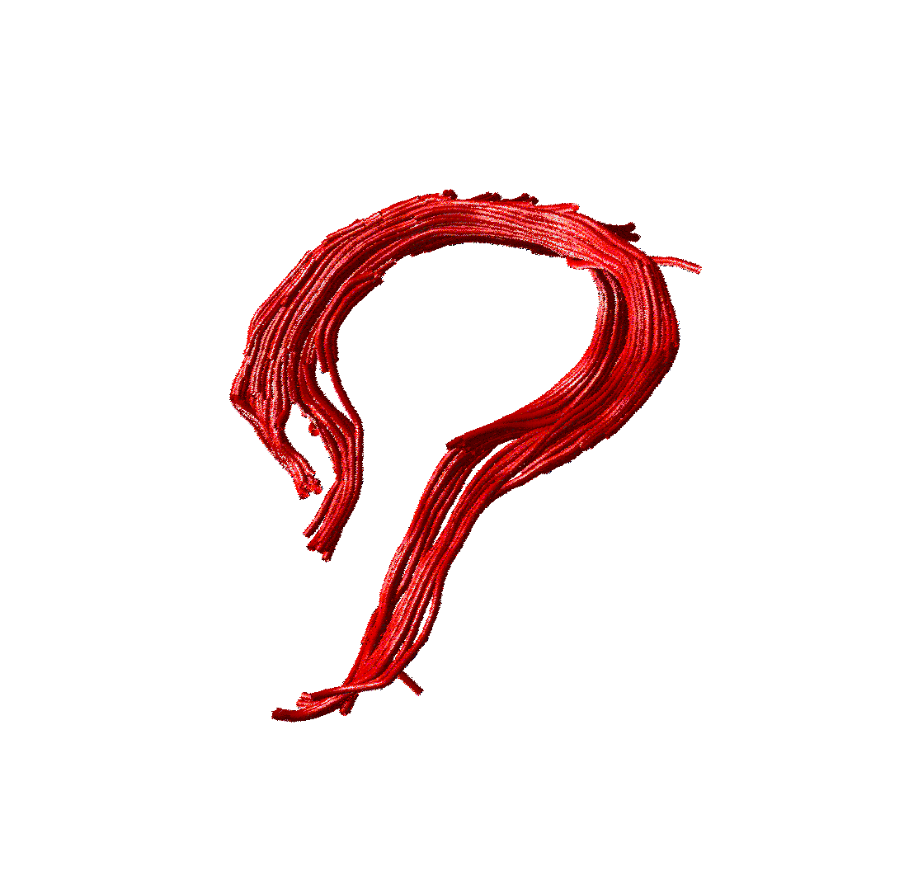
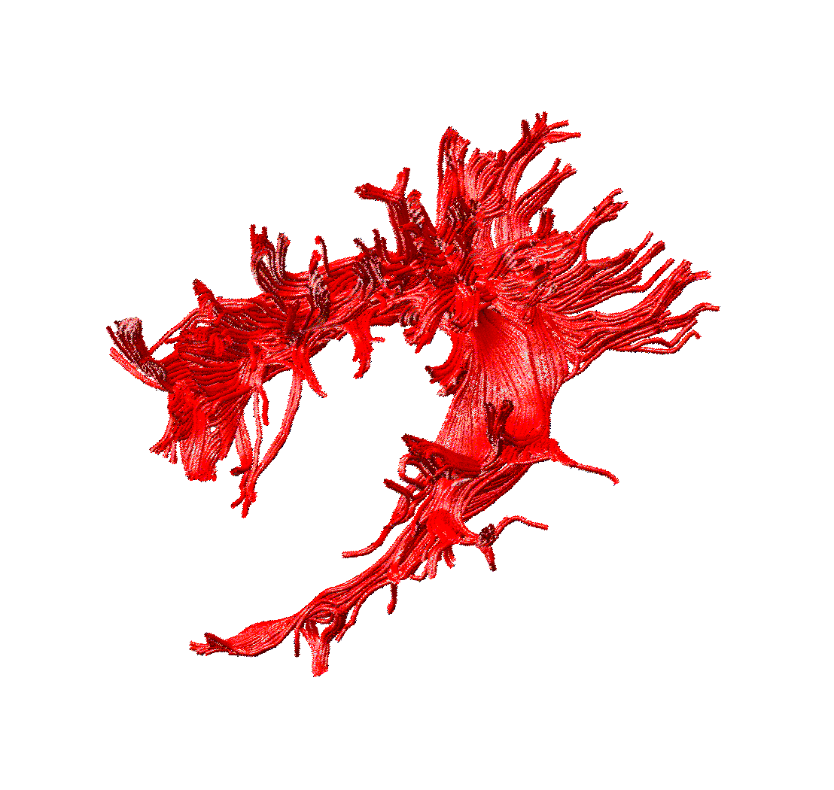
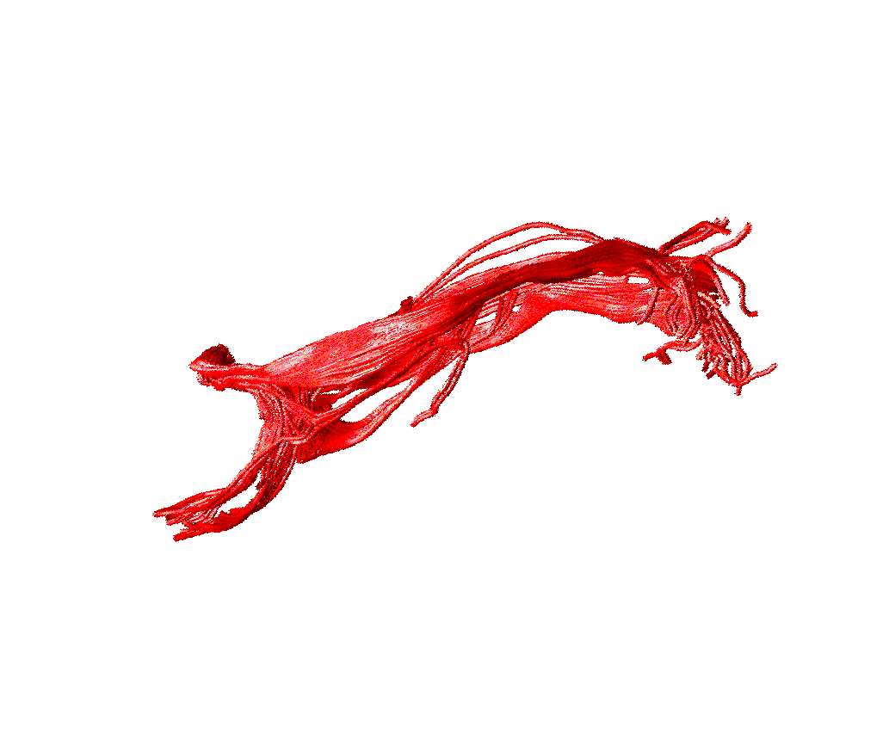
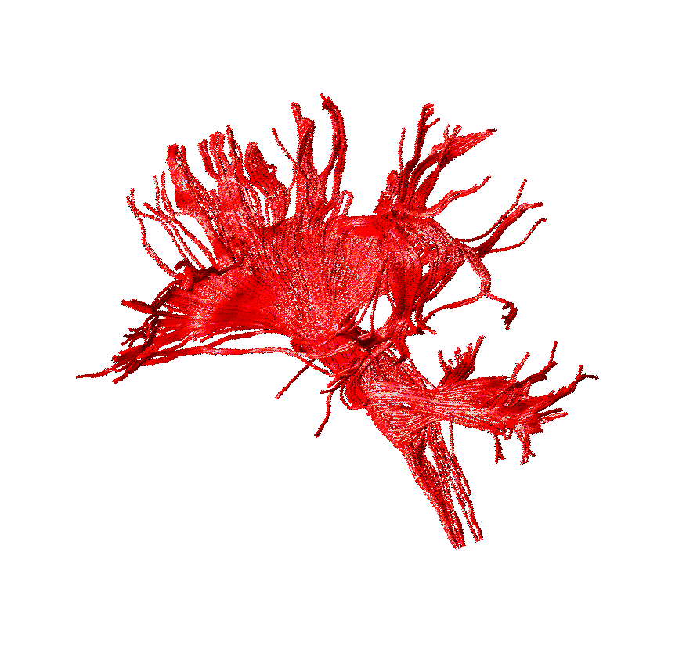
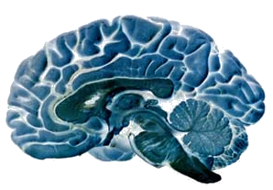
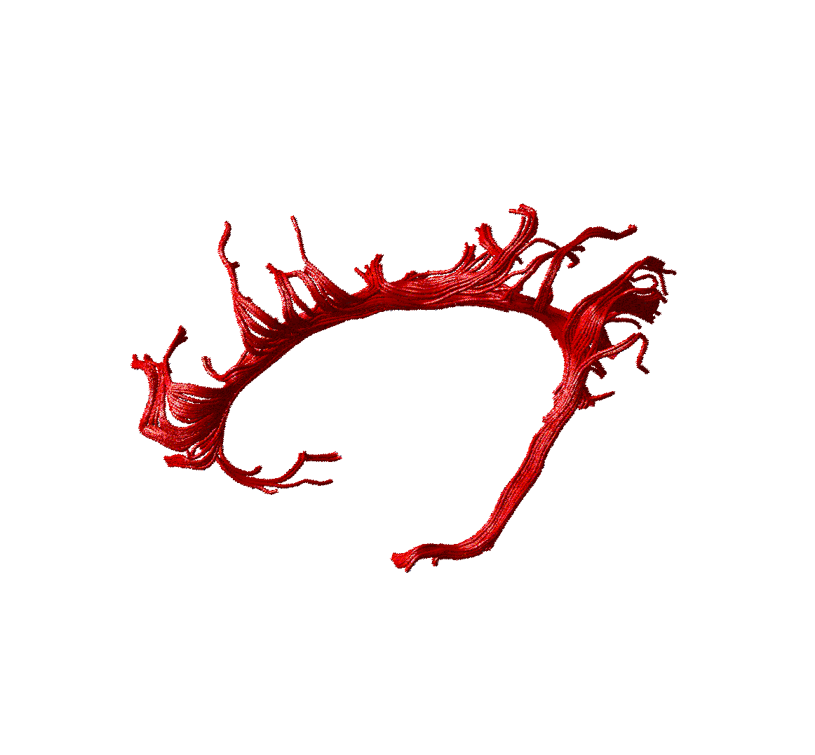
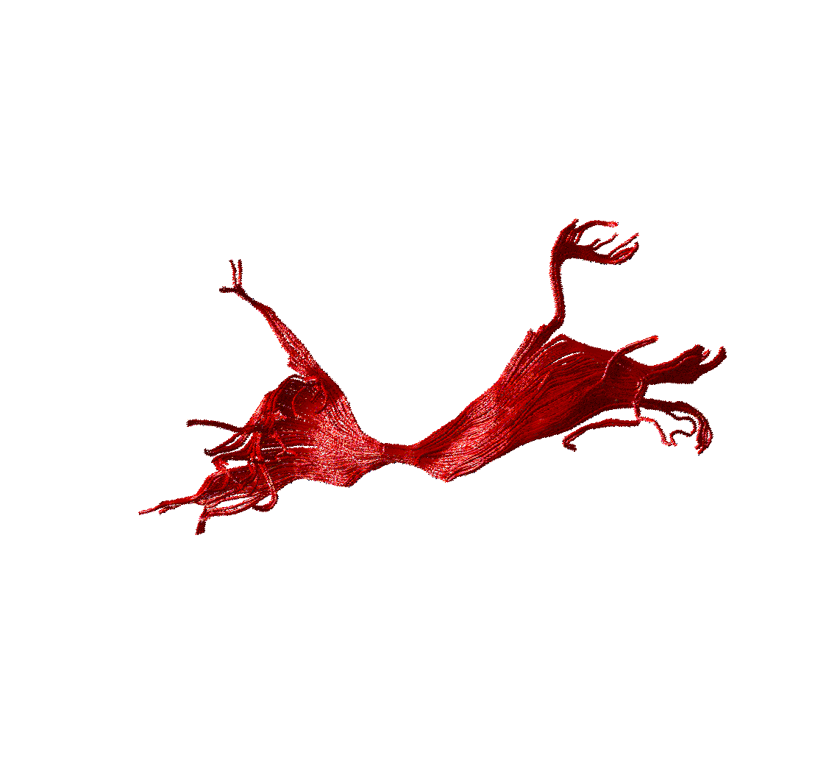
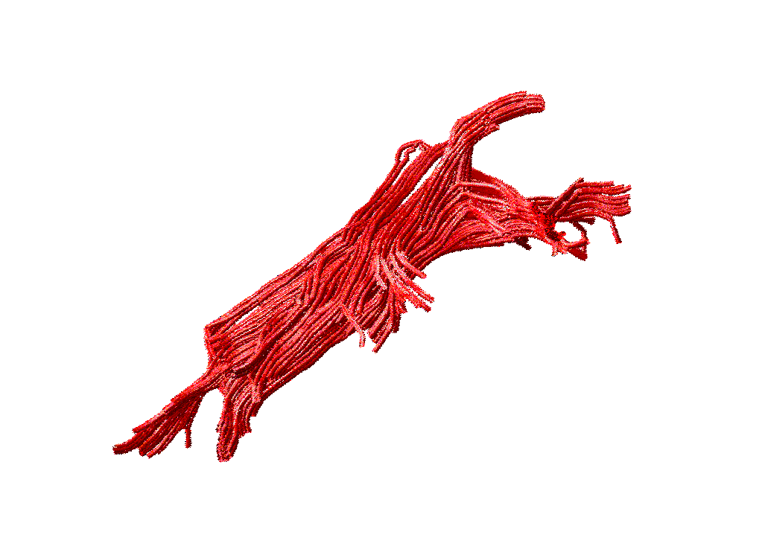
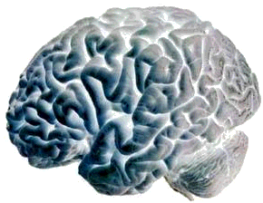
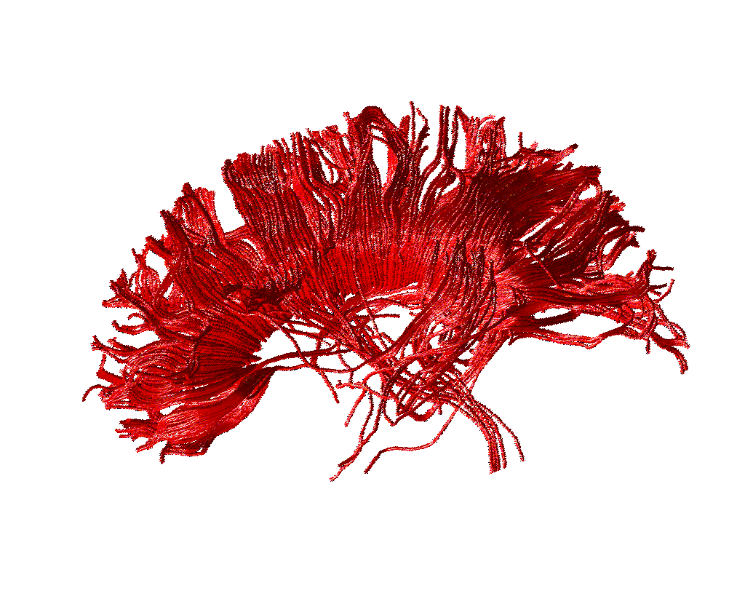
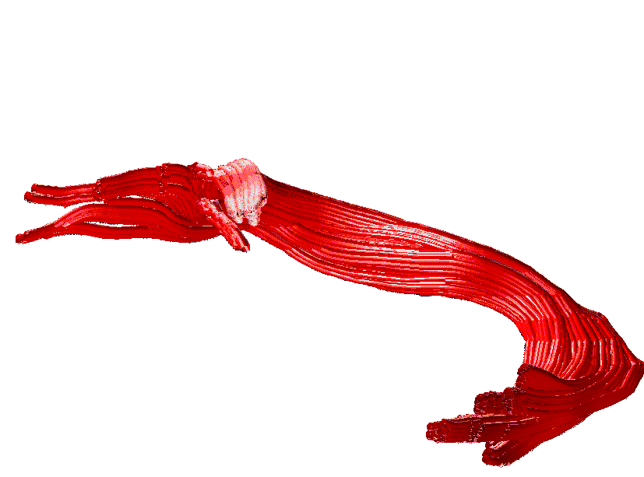
The result
ASSOCIATION
PROJECTION
Cingulum
Inferior longitudinal
Corona radiata
Fornix
COMMISSURAL
Arcuate
Uncinate
Inferior fronto-occipital
Corpus callosum
Anterior commissure
Catani et al., Brain 2005

Slide 21
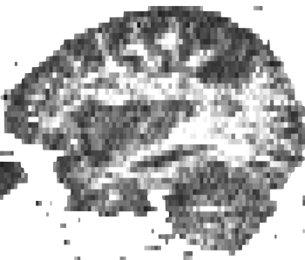
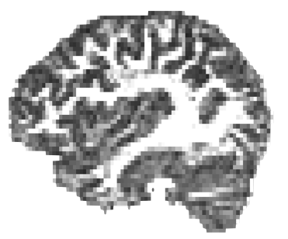
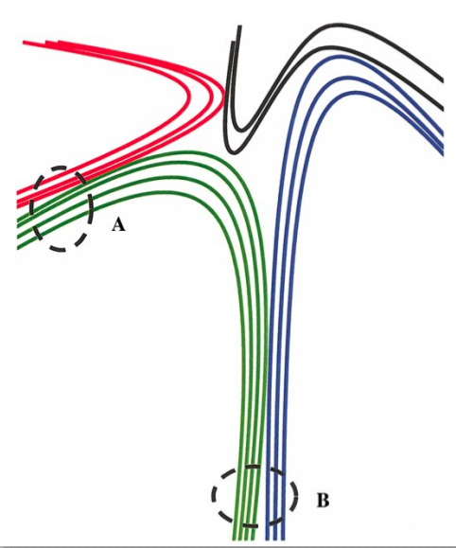
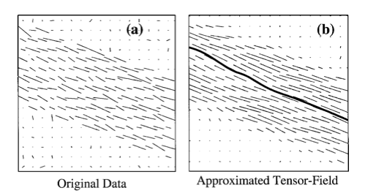
Data quality
low SNR
high SNR

Slide 22
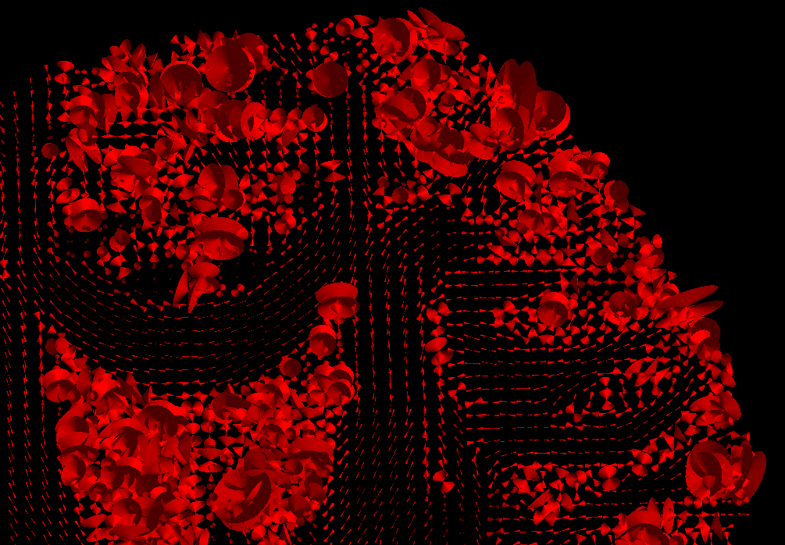
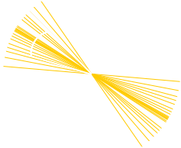
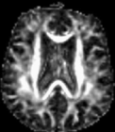
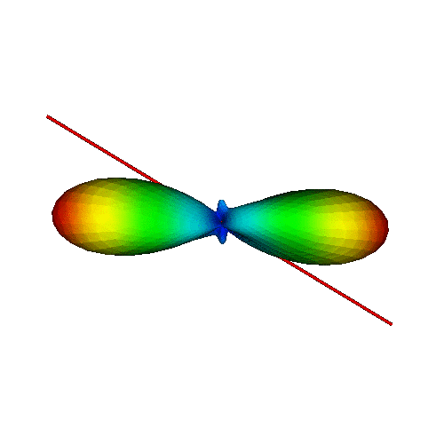
Orientation variability
Measuring variability
95% “cone uncertainty”
Courtesy of Derek Jones
Accounting for variability
sample from a distribution
Courtesy of Maxime Descoteaux

Slide 23
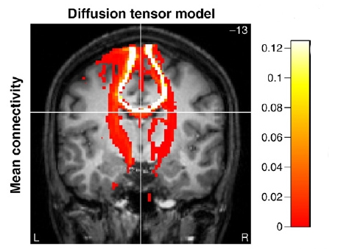
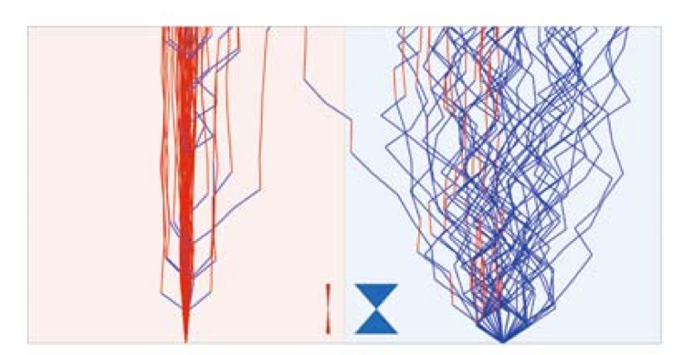
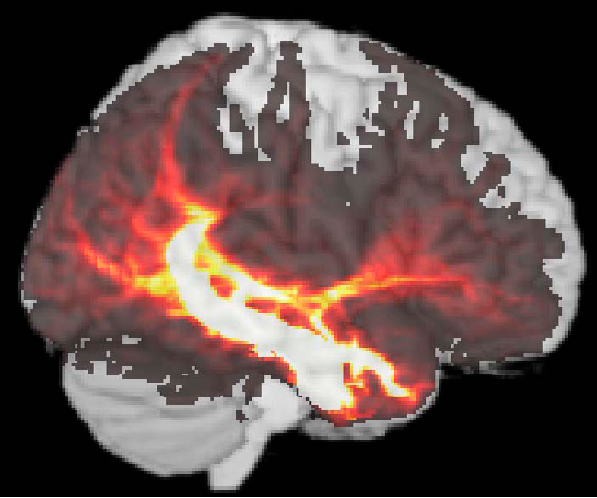
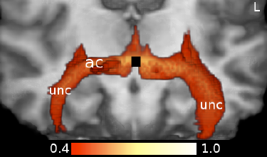
Probabilistic Tracking
A streamline is repeated multiple times from the same seed to map the intrinsic variability or uncertainty in the data.
Low Uncertainty
High Uncertainty
Kaden E et al.Neuroimage, 2007
PICO : Parker GJ, et al. MRM, 2003
The results are described with probability/connectivity” maps
The intensity represents the number of streamlines per voxel.
Descoteaux M et al. TMI, 2009

Slide 24
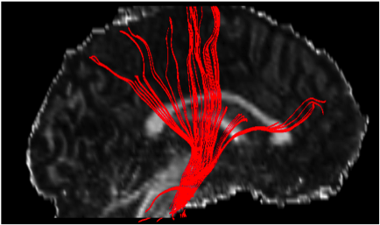
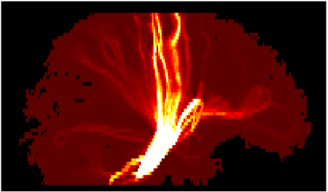

Probabilistic Tracking
Deterministic
Probabilistic
Low Reproducibility
High Reproducibility
Mapping the uncertainty is not mapping the anatomical probability
Behrens et al., Neuroimage 2007

Slide 25
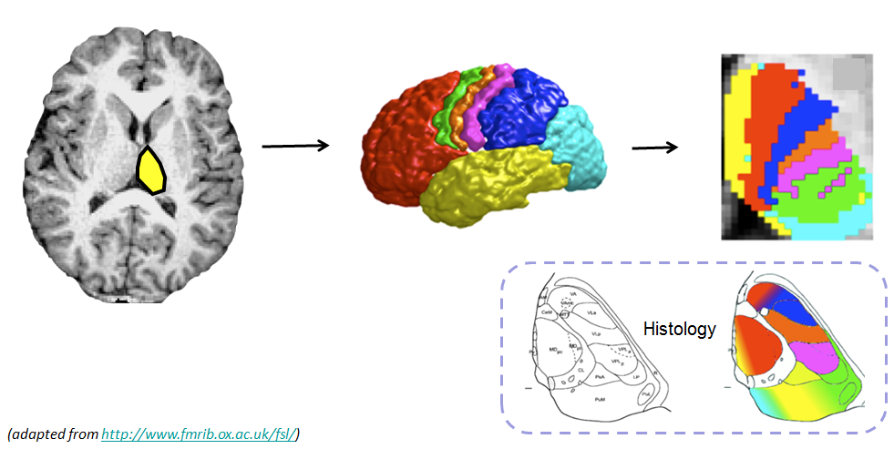
Connectivity-based region classification
“Non-invasive mapping of connections between human thalamus and cortex using diffusion imaging”.
Behrens, Johansen-Berg et al, Nature Neuroscience, 2003

Slide 26
Things to remember
Tractography is not always commutative
- Tracking from A to B can be different from tracking from B to A !
Not all software performs tractography in the same way
Use all the brain as seed-regions and then ROIs are used to visualize only streamlines that pass inside them.
Others start tracking from a first ROI and then a second ROIs is used to “filter results”.
Some software includes Boolean logic rules on tracks and ROIs (AND, OR, NOT) and other operators like CUT or SPLIT to remove “spurious” tracks

Slide 27
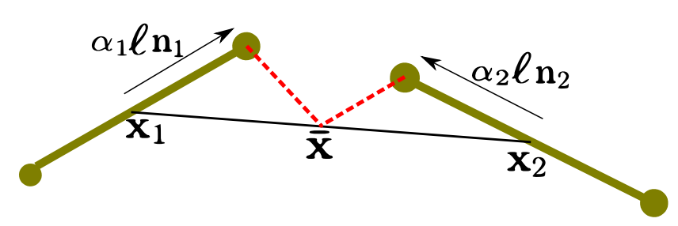
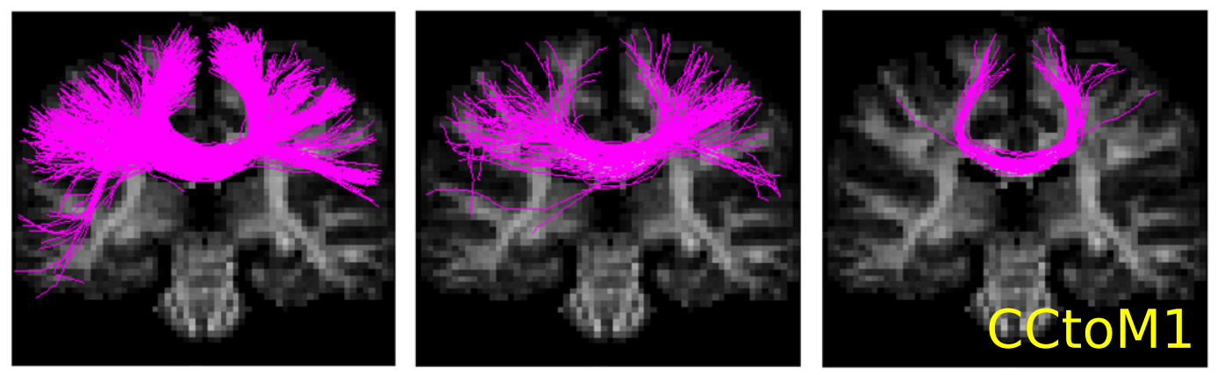
Other methods
Global tracking
Reisert et al. Neuroimage 2011
Proposed
method
FACT
Many other methods (Graph-based, Bayesian etc.)
For a thorough overview see Sotiropoulos PhD thesis

Slide 28


Multiple orientations/crossings
DTI
HARDI
DTI
HARDI

Slide 29
Applications
of tractography
and some issues

Slide 30

`
Neurosurgical planning
Neurosurgical planning
Brain tumor
M. Descoteaux, M. Chamberland and D.Fortin using the Fibernavigator which supports real-time tracking
https://github.com/scilus/fibernavigator
National geographic - February 2014

Slide 31


Automatic tract dissection
Tractography based analysis

Slide 32

Automatic tract dissection
Garyfallidis et al. “Quickbundles”, Frontiers of Neuroscience 2012

Slide 33

Tractometry - group studies
FA₅
FA_{n-1}
FA₄
FA₃
FA₂
FA₁
Bells et al. ISMRM 2012, Assaf et al. Neuroimage 2013,
Catani et al, PNAS 2007, Lebel & Beaulieu HBM 2009, Forkel et al Brain 2014

Slide 34

Along length statistics
Yeatman et al. PLoS 2010

Slide 35


Connectomics
Chamberland, Descoteaux et al., HBM 2014

Slide 36

Rely on counting?
Courtesy of Marco Catani

Slide 37





Need for Validation
Wrong connections
False but plausible connections
> 50% of streamlines!
www.tractometer.org

Slide 38
Recent advances
in tractography

Slide 39

Reducing tractography biases
Masking, seeding, tracking parameters reduce the quantitative strength of comparing bundles of different length, position, width and curvature

Slide 40

White matter, gray matter, CSF priors for tracking
white matter
gray matter
CSF
Girard et al 2012, NeuroImage 2014,, Smith et al. NeuroImage 2012

Slide 41

Some results
Without anatomical priors (probabilistic tracking)
Girard et al., NeuroImage 2014

Slide 42
Some results
With anatomical priors (probabilistic tracking)
Girard et al., NeuroImage 2014

Slide 43
Reducing tractography biases
Better seeding
reduces the length and curvature bias
Better management of boundaries
reduces length, volume and density biases
But don’t forget to register well your T1 to the diffusion data.

Slide 44
Summary
Make sure your preprocessing is done correctly.
Validate with what is known from anatomy.
Use priors if you can.
Seed from ROIs if it is possible.
Select your tracking method wisely. Check how much the method is validated.
Start with the default parameters but also investigate e.g. step size and angular threshold.
Use HARDI/FOD methods as input to tracking.
Do not count streamlines without critical thinking.

Slide 45
Tracking in
Diffusion Imaging in Python (DIPY) is a free and open library for dMRI and tractography algorithms.
Read the dipy paper [1].
Read tutorials in dipy.org
Deterministic and probabilistic examples are available.
Tracking with anatomical priors will be available with the next version.
[1] Garyfallidis et al., Frontiers in Neuroinformatics, 2014

Slide 46



Thank you
http://scil.dinf.usherbrooke.ca
http://tractometer.org

